Slide 1

BIG DATA TOOLS FOR MANAGERS
Unit-5 : Time Series using Python
by
Ankit Velani
Adjunct Faculty, Dept. of MBA,
Siddaganga Institute of Technology,Tumkur

Slide 2
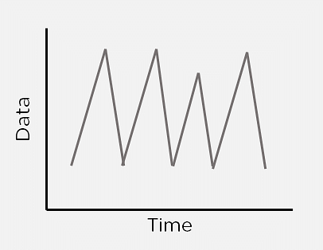
What is Time Series Analysis?
Sometimes data changes over time. This data is called time-dependent data. Given time-dependent data, you can analyze the past to predict the future.
The future prediction will also include time as a variable, and the output will vary with time. Using time-dependent data, you can find patterns that repeat over time.
A Time Series is a set of observations that are collected after regular intervals of time. If plotted, the Time series would always have one of its axes as time.

Slide 3
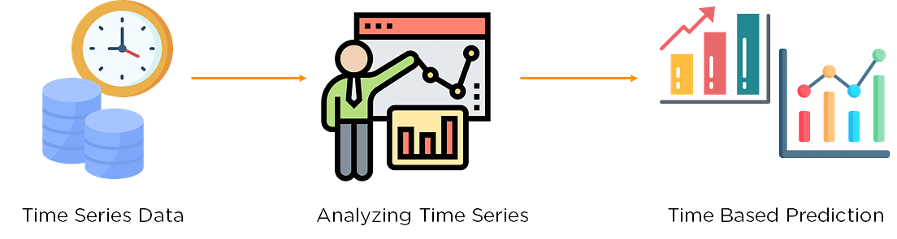
What is Time Series Analysis?
Time Series Analysis in Python considers data collected over time might have some structure; hence it analyses Time Series data to extract its valuable characteristics.

Slide 4
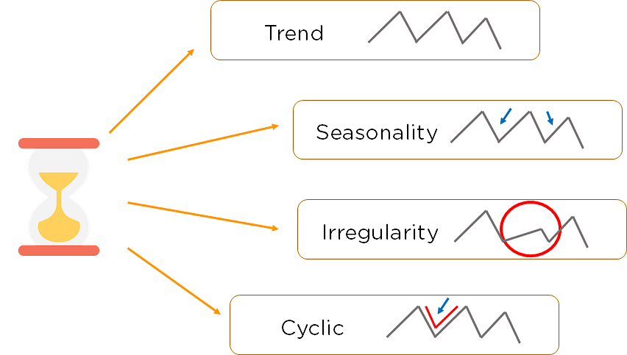
Components of Time Series

Slide 5
Components of Time Series
Trend:
The Trend shows the variation of data with time or the frequency of data. Using a Trend, you can see how your data increases or decreases over time. The data can increase, decrease, or remain stable. Over time, population, stock market fluctuations, and production in a company are all examples of trends.
Seasonality:
Seasonality is used to find the variations which occur at regular intervals of time. Examples are festivals, conventions, seasons, etc. These variations usually happen around the same time period and affect the data in specific ways which you can predict.
Irregularity:
Fluctuations in the time series data do not correspond to the trend or seasonality. These variations in your time series are purely random and usually caused by unforeseeable circumstances, such as a sudden decrease in population because of a natural calamity.
Cyclic:
Oscillations in time series which last for more than a year are called cyclic. They may or may not be periodic.
Stationary:
A time series that has the same statistical properties over time is stationary. The properties remain the same anywhere in the series. Your data needs to be stationary to perform time-series analysis on it. A stationary series has a constant mean, variance, and covariance.

Slide 6
Time Series Common Algorithms
_{Autoregression (AR)}
_{Moving Average (MA)}
Autoregressive Moving Average (ARMA)
Autoregressive Integrated Moving Average (ARIMA)
Seasonal Autoregressive Integrated Moving-Average (SARIMA)
Seasonal Autoregressive Integrated Moving-Average with Exogenous Regressors (SARIMAX)
_{Vector Autoregression (VAR)}
Vector Autoregression Moving-Average (VARMA)
Vector Autoregression Moving-Average with Exogenous Regressors (VARMAX)
Simple Exponential Smoothing (SES)
Holt Winter’s Exponential Smoothing (HWES)

